Slide 1
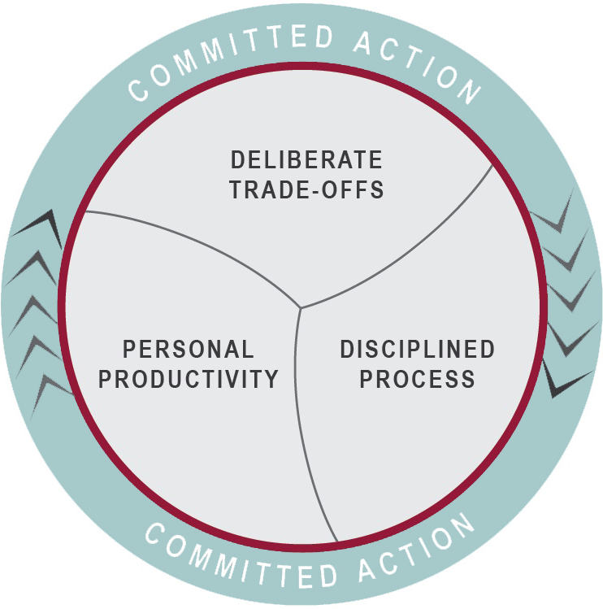
Committed Action
Committed Action is a powerful practice that leaders and teams can use to cultivate a more conscious culture, one capable of getting better and better at execution

Slide 2
What really is Execution?
Execution is simply how groups get things done
Very few initiatives have a clear beginning and end in the “real world” but naming and tracking drives behaviors and generates results
What we really want is to make steady progress on the things that matter most despite the ‘whirlwind’ surrounding us

Slide 3
Common Pitfalls
Trap | Observable Behavior | Way out
Too Many Priorities | Don’t make steady progress on our 2x2 initiatives | Deliberate Trade Offs using the 2x2 as the organizing tool 3-5 Selectively Invest & Drive Daily Use Gamefilming to ‘get real’ about our actual bandwidth / capacity
Incongruent / Not Walking our Talk Aren’t Deliberately Practicing with Tools and Skills | The 2x2 isn’t showing up in our day to day conversations We are working on things not reflected on our 2x2 | Tie meetings/discussion to specific 2x2 Initiatives If it isn’t on the 2x2 be curious as to why you are discussing Does it need to be on the 2x2? Use Delay/Ignore +NO to explicitly coach behavior
Not Aligned on Commitments – Who Will Do What by When? | Lack of clarity about who ‘owns’ initiatives Avoiding accountability and breakdown conversations | Assign one person per initiative as owner Explicitly address resistance to awkward conversations and build skills with practice Use a transparent system to record and track progress

Slide 4
Prompting Questions
What pitfalls are you experiencing in your organization that are impeding your ability to make progress on your initiatives?
What types of trade-off’s do you find it difficult to make? What is hard for you or your team to Delay, Ignore, or say a positive NO to? Why?

