Slide 1
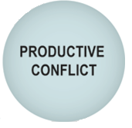
HPT Practice Integration
Walk the Talk
Ongoing Regard
Trust Formula
Escaping the Drama Triangle
Recalibration, Redirecting Energy
SBI, Telling Ourselves Stories, Active Listening
Council Mode
Vision
2x2 Prioritization Matrix
Project Planning
Committed Action
Task Management
Attention Management
Vision (Goals)
Gamefilming (AAR)

