Slide 1
The Next Level
Next Level
You cannot solve a problem from the same level of thinking that created the problem.
– Albert Einstein
Current Level

Slide 2
Root Causes and Results
“Being”
“Doing”
Next Level Thinking & Inner State
Next Level Behavior
Next Level Results
Current Level Thinking & Inner State
Current Level Results
Current Level Behavior

Slide 3
Context
Future Way of Being and Doing
(Creative)
Results
Current Way of Being and Doing
(Reactive)
Time

Slide 4
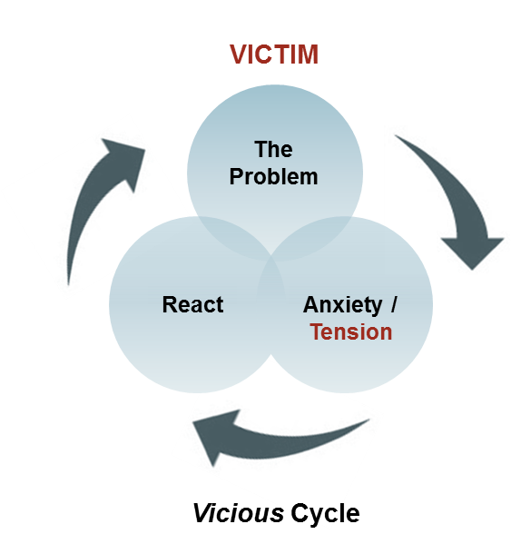
Context
Future Way of Being and Doing
(Creative)
Results
“Tension Relief”
Current Way of Being and Doing
(Reactive)
Time

Slide 5
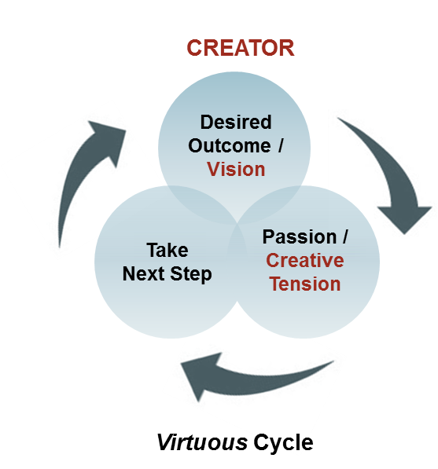
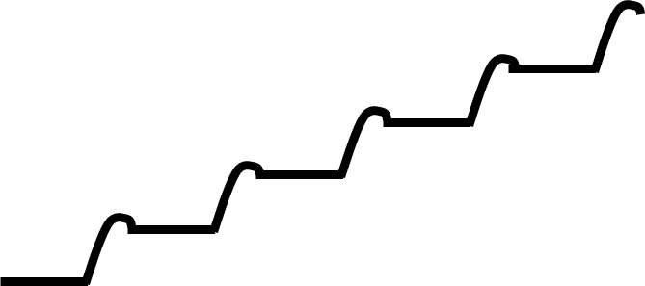
Context
“Creative Tension”
Results
Current Way of Being and Doing
(Reactive)
Current Way of Being and Doing
(Creative)
Time

