Slide 1
Advanced Execution Workshop Q1
1/21/2015

Slide 2
Ground Rules
We will use these Ground Rules for our Advanced Execution interactions
Time Out
Permission to be Messy
Everyone Participates
Ask, Ask, Ask
Phones Off
Be Fully Present
Speak Concisely
Challenging is OK
Everything on the Table
Stick to the Agenda
Be Respectful

Slide 3
Driversselect Initial 2x2
Improve Vehicle Quality Standards Through Recon
Balance Vehicle Purchases
Sustain Location Staffing
Maintain Lender Relationship
Build Recon Operations
Better Customer Exp. w/ Defined Expectations
Speed of Trust
Improve Sales Process & Educate CEOs
Use of CRM
Manage to Establish 3 appts/week/CEO
Daily Commitments Production
Associate Development
Advanced Execution
Align Sales/Recon/Purch Goals
Improve CEO Productivity
ID Alternatives for Vehicle Sourcing
Increase Rate of NPS Surveys 100%
Continuous Training & Development
Promote New Job Openings Internally
Continuous Recruitment in Sale/Recon/Acct
Internal Advancement Opportunities
Develop Core Brand Messaging
New Lender Program
Time Blocks / Structured Meetings
Manage ACQ Fee Strategy
Implement Purchasing Strategy
Tweak Pricing Strategy
Hire 2 CEOs Per Month
Manage 60+ Day Inventory
Expand Location & Storage Lot
Rebuild Website to Reflect Brand
Reduce 60+ Inventory <15%
Secure New Floor Plan
New Culture Events/Delivery
Test Home Delivery
New Lender Relationship
Include Eric & Ramon in Weekly PurchGamefilming
Digital User Experience Surveys
Create Best Practices Play Book for CEOs
Deed Sub Prime
+1,000 ACQ Fee
Self Desking
New Banks
Research Locations for New Location
Introduce New Metrics for Daily Huddles
Plan for Future Growth, Inv, Capacity, Storage
Maintain Bank Relationships
Tribe Member Development Plans
Consignment Model
Traditional Advertising
New Car Franchises
New Training Initiatives
Learn About Home Delivery
Secure New Floor Plan
Test New Marketing Messages
Research Customer Self-Desking
New Location
High Risk High Reward Purchases
Purchasing Old Vehicles
Own Bank
Research New Pricing Model
Test Activating Promoters
2nd Location

Slide 4
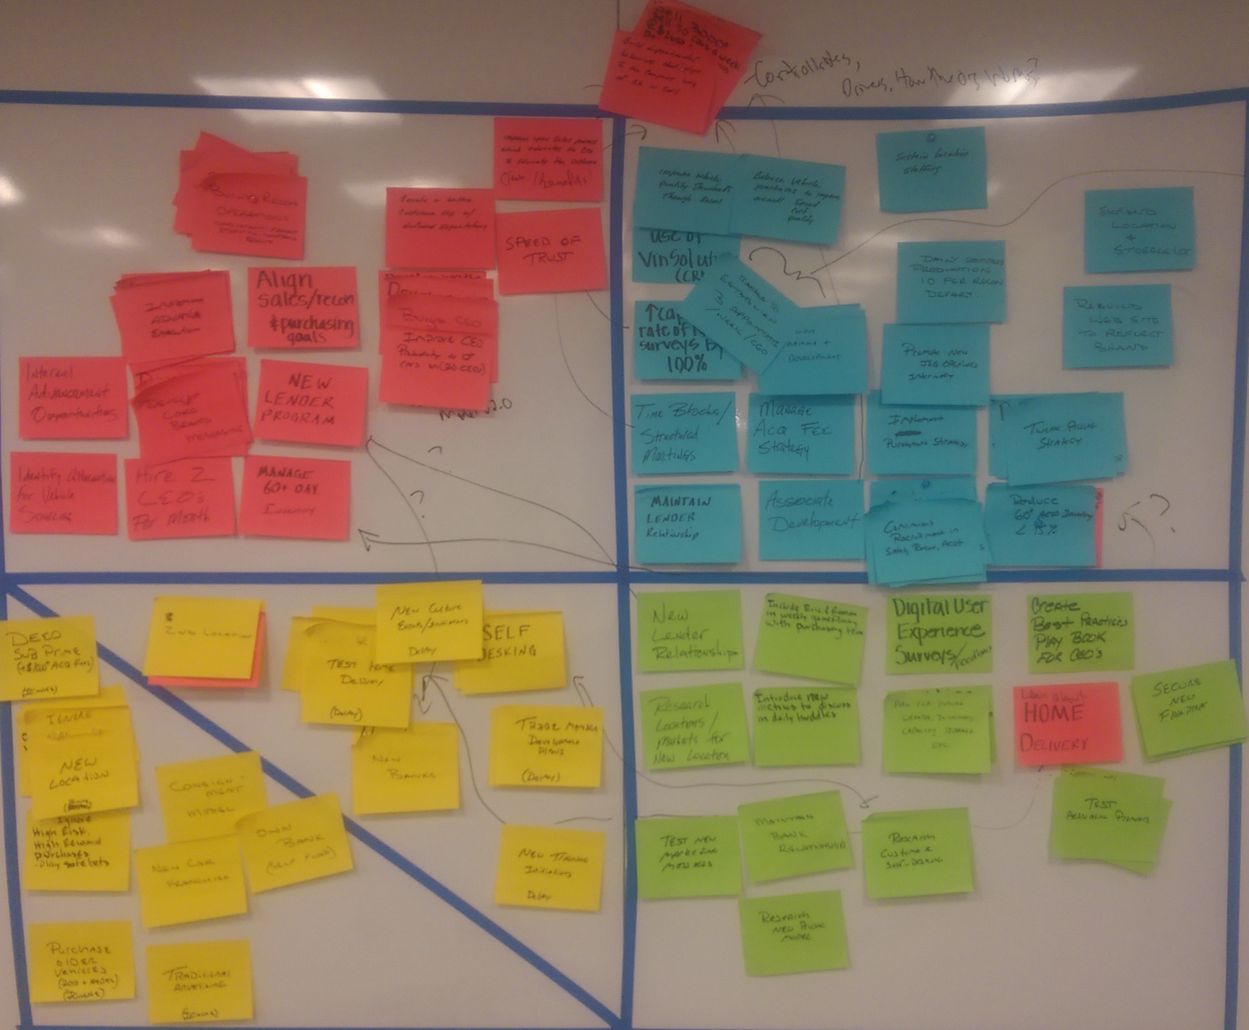
Workshop 2x2
“Controllables”
Sell 50 Cars/week @ $2600 GM
Build Behaviors to Align to WIG (3,000 Cars)
Grow Sales 100 Units each QTR
“Develop Sales Model v2.0”
“Disciplined Execution of Sales Model v1.0”

Slide 5
Key Questions
At the Company Level, how should these initiatives be prioritized, and should some be consolidated (are they pieces / steps of a broader company-level initiative)?
New Lender Program – Is this a Selectively Invest, Delay, or Work In?
Manage Inventory 60+ Days Old – Is this a Selectively Invest or Drive Daily?
Develop Sales Model 2.0 vs. Disciplined Execution of Sales Model 1.0
  We have some things we can execute on now vs. improve / better train & develop our CEOs to reach our 3,000 WIG
Self Desking – Is this a Work In or Delay?
Home Delivery – Is this a Work In or a Delay?
Can we consolidate these initiatives into one manageable chunk?
  Internal Advancement Opportunities
  Promote New Job Openings Internally

Slide 6
Picture References

Slide 7
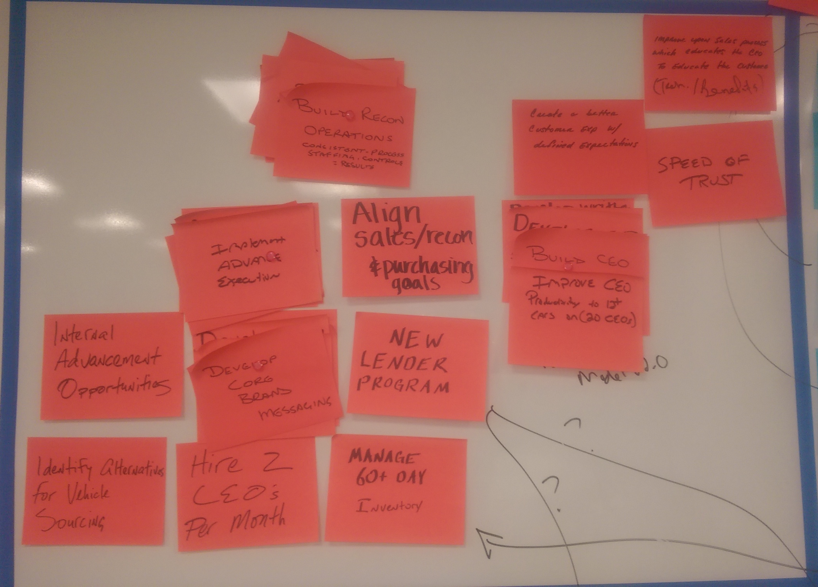
Selectively Invest

Slide 8
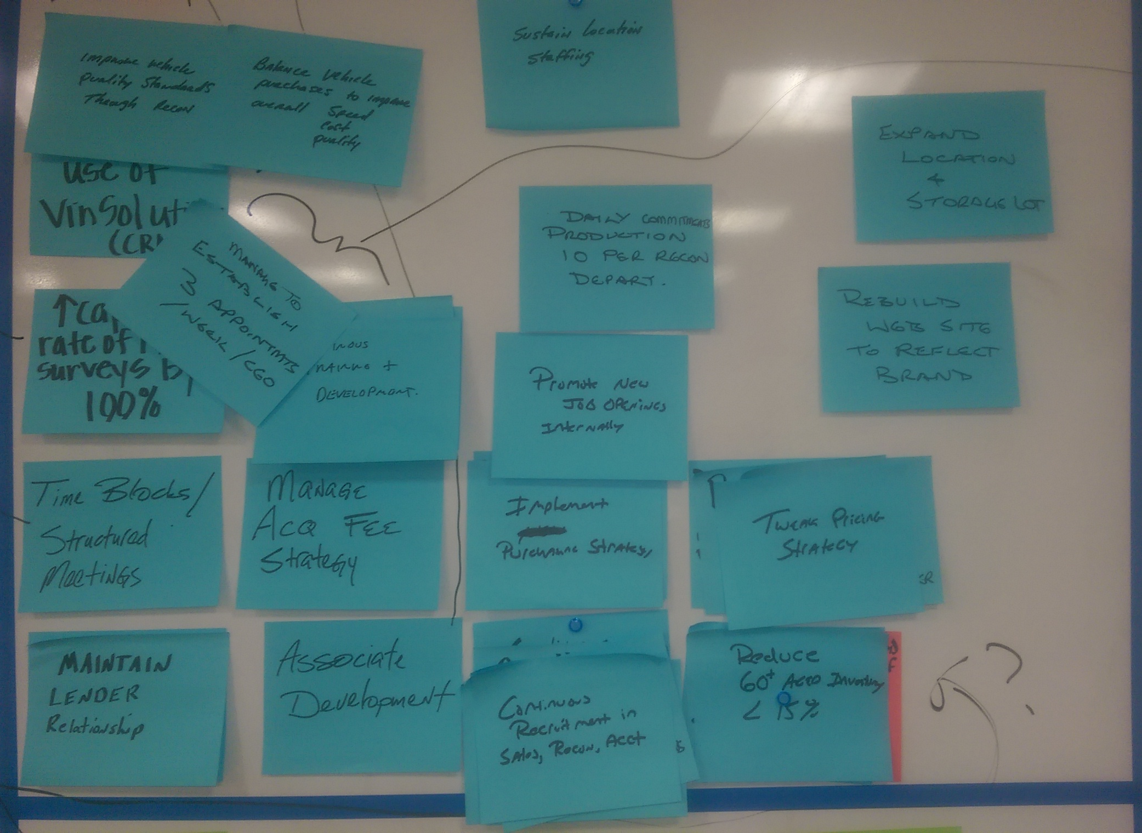
Drive Daily

Slide 9
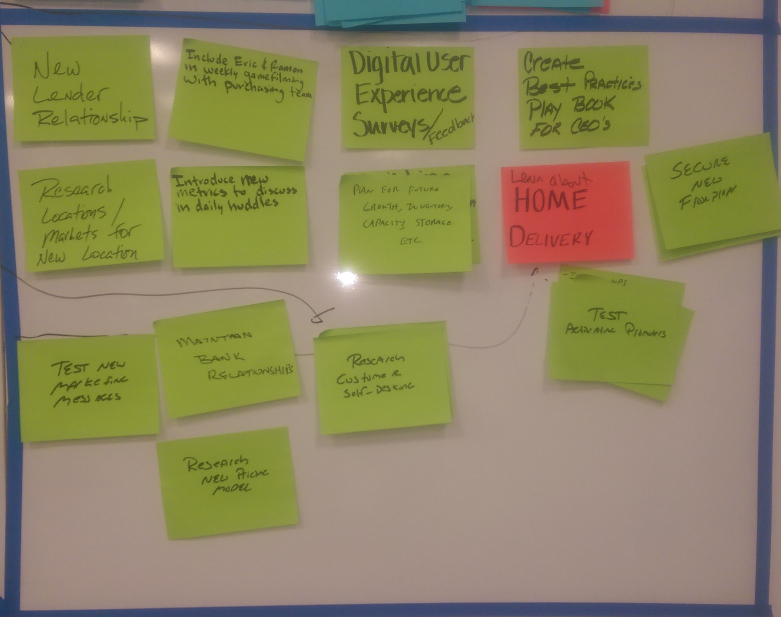
Work In

Slide 10
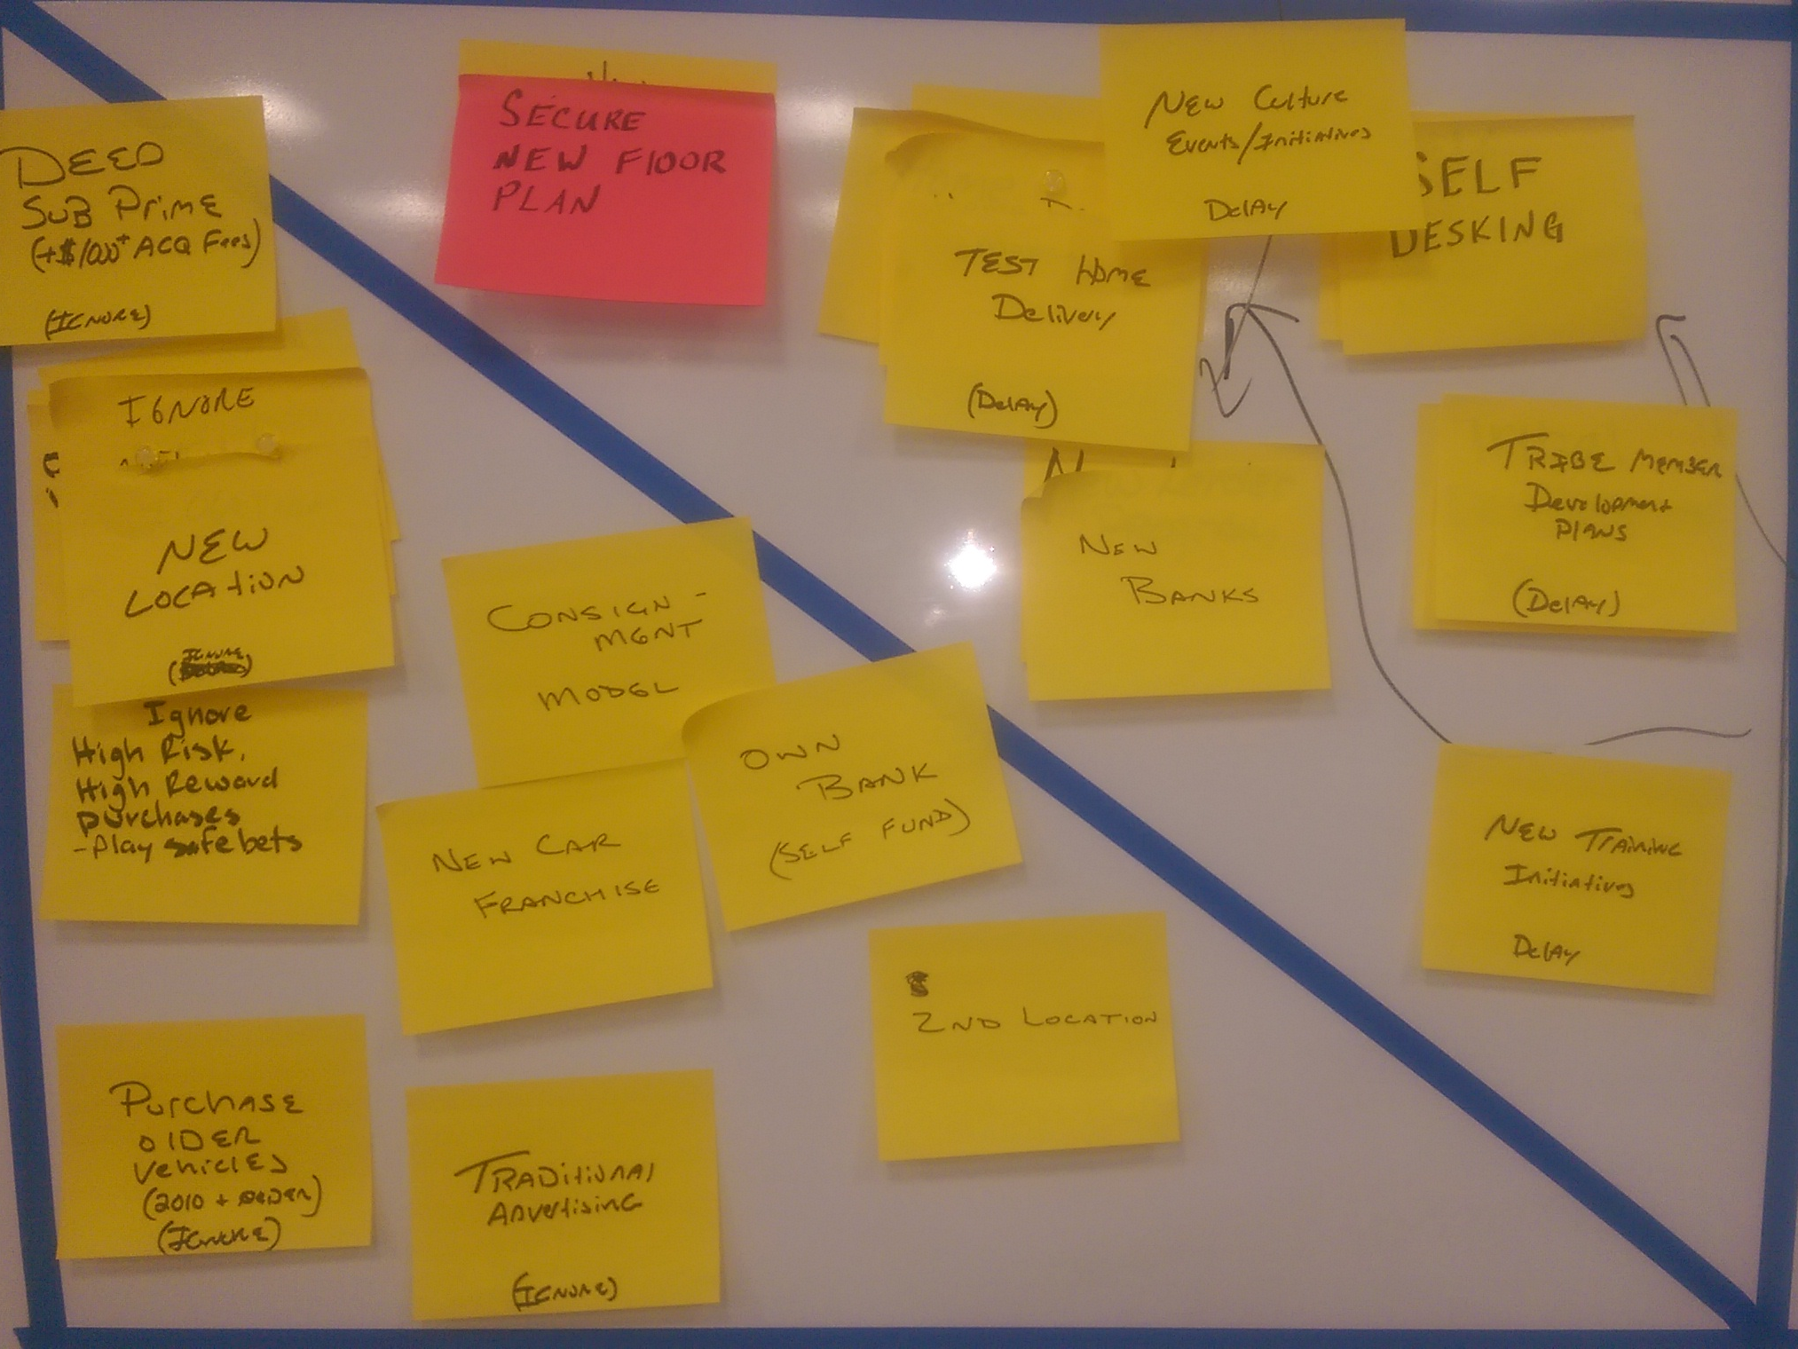
Delay / Ignore

