Slide 1
Council Mode
Council Mode is a very traditional group communication approach that simply has each person in a group state their position in identical preset time limits with no questions or interaction. Used in parliamentary settings, elder councils, etc., hence the name.
Source: Based on the work of Mark Gerzon

Slide 2
Council Mode
Questions
Active Listening
Active Listening
Comments
Active Listening
Active Listening

Slide 3
Council Mode Application to Modern Organizations
At times, a group may be so deep or stuck in unproductive conflict that the leader is unable to manage or resolve the situation
In these circumstances, shutting down unproductive interaction and allowing each person to express their unilateral position can get all the perspectives and feelings surfaced in order to see where the group really stands

Slide 4
Council Mode Practice
Call a time out to break the flow
Ask permission to use Council Mode
Explain Council Mode
Choose a starting speaker and a time limit (usually 1 – 5 minutes)
Remind the non-speakers to be in Active Listening mode only
Enforce the no questions or comments rule if necessary by calling time out
Take what you learn from Council Mode and re-enter Productive Conflict

Slide 5
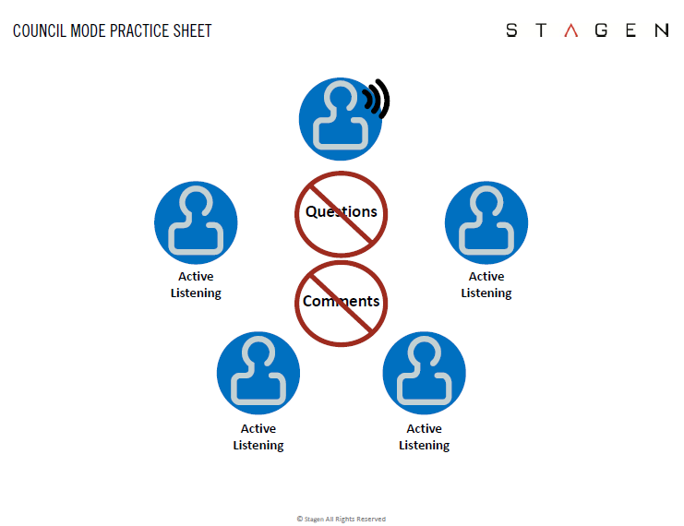
Council Mode Exercise

Slide 6
Council Mode Exercise: Table Group Discussion
Choose a mildly controversial topic
Choose a timekeeper: 1 minute per speaker
Indicate a beginning speaker
Remember:
  Active Listening Mode
  No Questions
  No Comments

Slide 7
Council Mode Debrief
How did that feel?
  As you listened?
  As the speaker?
What did you learn?
Do you see any applicability for this approach?

Slide 8

Takeaways

