Slide 1
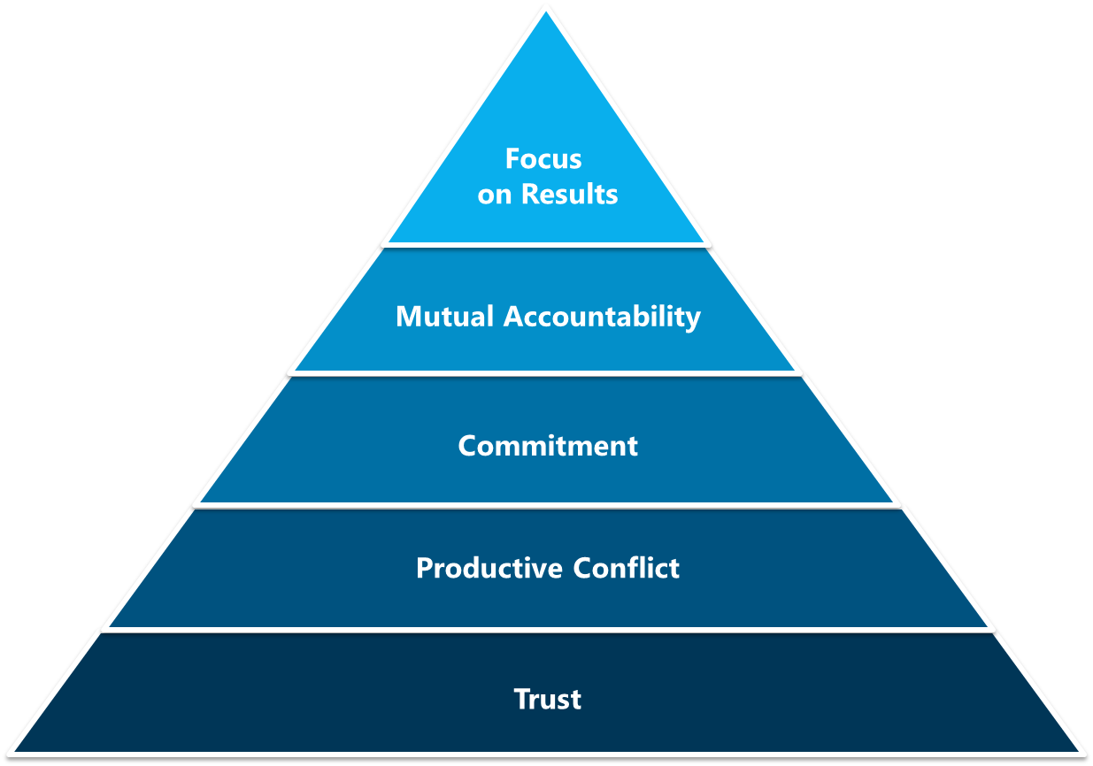
High Performance Teams
A Little Background…
SLALOM BUILD ALL RIGHTS RESERVED. PROPRIETARY AND CONFIDENTIAL.

Slide 2
High Performing Teams
Let’s Get Started: Coat of Arms Exercise
Complete the shield with drawings only, no words
What is something from your childhood that significantly influenced who you are today?
What is a foundation in your life that keeps you grounded?
What is a hope that you have for someone?
What is a current dream of your own yet to be fulfilled?
1 personal motto – at the bottom
SLALOM BUILD ALL RIGHTS RESERVED. PROPRIETARY AND CONFIDENTIAL.

