Slide 1

Who I was B.S.(Before Stagen)
Hurried, Knower, Obsessive Approach, Distracted Behavior, Not Present

Slide 2

Goodbye
Super Woman

Slide 3
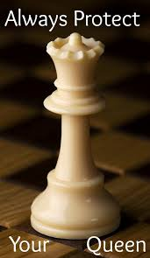
Hello, Queen!
Protect the Queen
Say no to more things
POSITIVE NO
Be a Creator for my King!

Slide 4

My theme this year: Be Deliberate
Experts are Made, Not Born
Deliberate practice develops expertise

Slide 5
Being a Creator

Slide 6
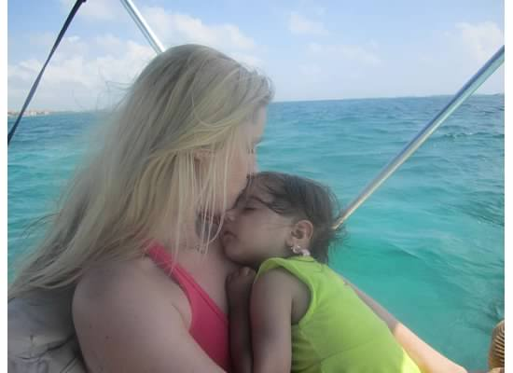
Being present
High Energy
High FOCUS
Keep recommitting to this
Belize – no phone for 4 days

Slide 7

Self-coaching
Finding my “&”
My gap in leadership effectiveness:
Viewing issues in “black and white”
Being one-sided. Instead, view issues as “and” – seeing opportunity for development.

Slide 8
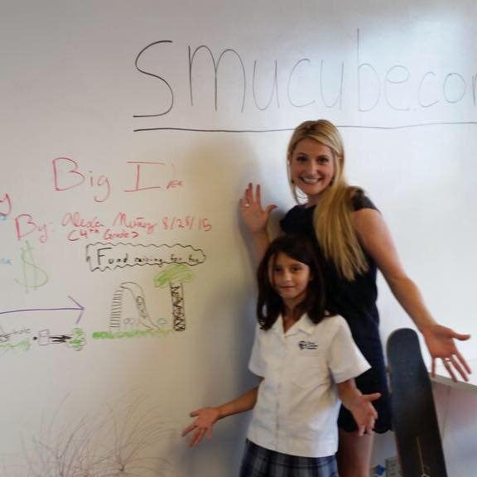
Living my purpose:
Joyfully propelling others forward

