Slide 1
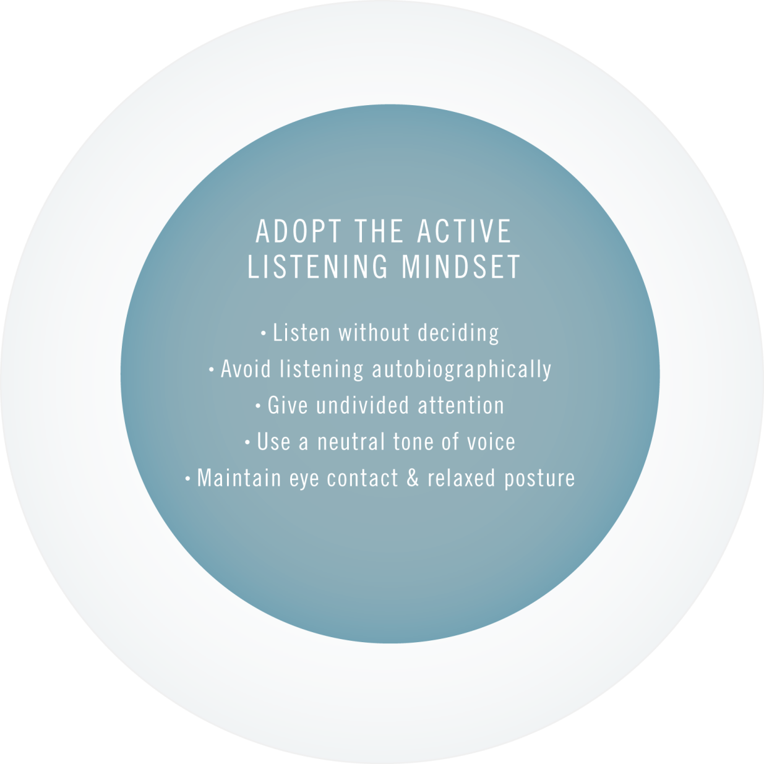
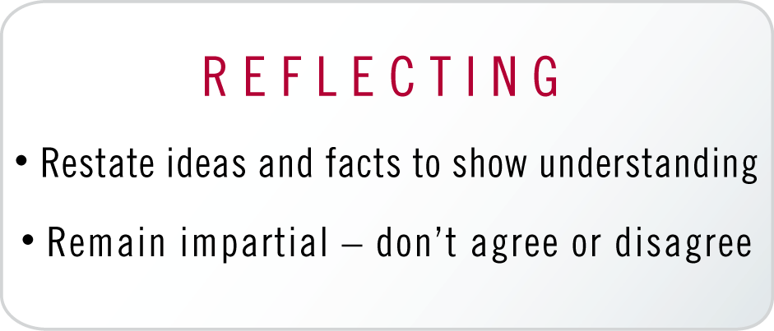
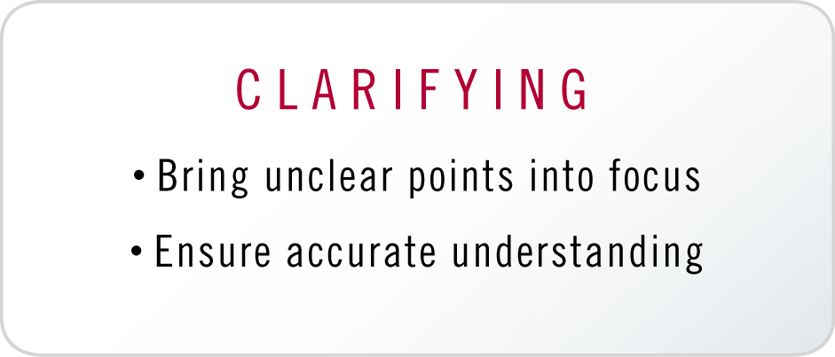
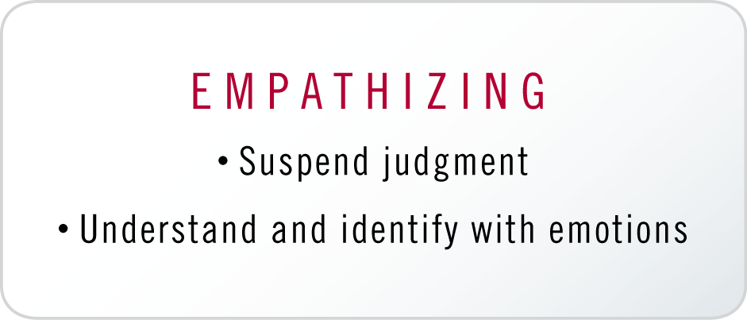
Active Listening Core Practice

Slide 2
Active Listening Practice
Instructions:
Active Listener A asks open-ended questions, goes through the open doors, and asks follow-up questions.
Speaker B answers the questions.
After five minutes, switch roles.

