Slide 1
2014 Organizing Documents
Stagen
January 1, 2014

Slide 2
2014 Plan

Slide 3
Firm

Slide 4
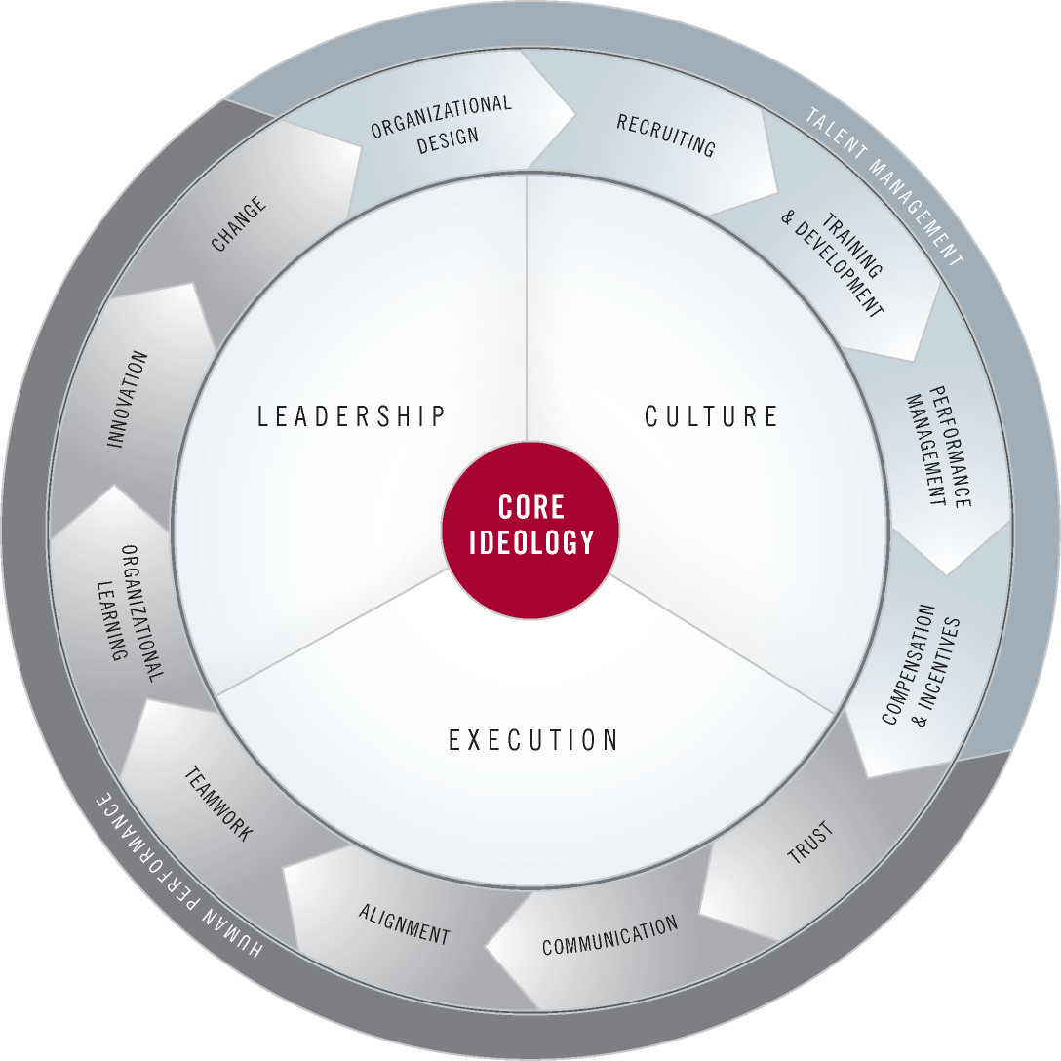
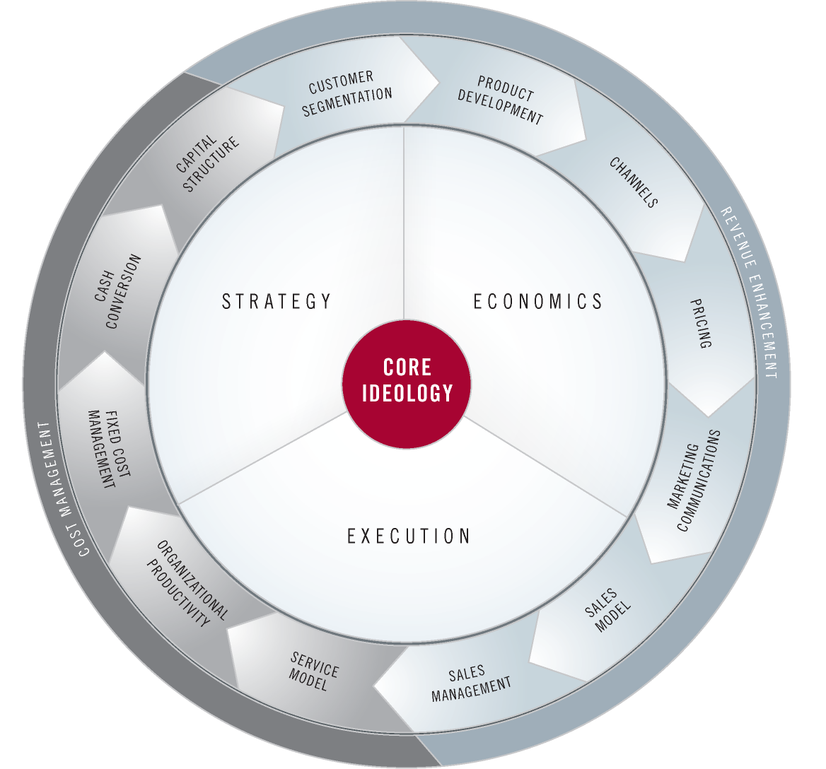
2014 Theme
Maintain momentum and flourish
People
Operations
side of the business
side of the business

Slide 5
flourish
grow or develop in a healthy or vigorous way, especially as a result of a particularly favorable environment

Slide 6
Stagen 2014 Imperatives & Initiatives
Flourish
Deepen Relationships among our Team
Cultivate our Practice: Invest more Time & Resources in Training & Development
Integrate Inspiration and Perspiration: Purpose & Guiding Principles Mojification
Bring the Academy Alive for our Community: Leadership Clubhouse, 21st Century Plato
Extend Platform Team and balance with some new Core Team
Engage the Team to Expand and Experiment with Talent Pools
Practice Personal Productivity and Professionalism with our Tools
Maintain Momentum
Build v0.9 Leadership Academy Service Model: Virtual & Physical
Institutionalize and Spread the Story: Small, Tangible beyond Founder Marcom Milestones
Disciplined Enrollment of Active Recruits with Balance in the Funnel
Effective Product Development: Balance Content, Delivery Practices & Platforms
R&D Academy Elective Pilots to Learn about Longer Term Engagement Possibilities: Conversations with Masters Teleseries, Quarterly Workshop Series, The Work in Leadership, Dragon Gap, Fridays on the Mat, Individual Coaching
Advanced Execution Operating Group Elective Year II
Selectively Engage YPO and Deepen Western Region Relationships

Slide 7
Stagen 2014 Priorities
High
Selectively Invest
Drive Daily
Disciplined Enrollment & Balance Funnel
Spread the Story
Member Engagement R&D Elective Pilots
Mojification
Invest in Training & Development
Effective Product Development
Deepen Relationships
Leadership Academy Service Model v0.9
Bring Academy Alive
Extend Platform Team
Advanced Execution II
Value
Delay
Work In
Experiment with Talent Pools
Productivity & Professionalism
Ignore
Major R&D
Strategic Working on the Business
Premature Channel Expansion
Selectively Engage YPO
Low
High
Effort / Cost
Low

