Slide 1
Human Resources 2 X 2 Talent Management FY2019
2x2 Working Session
September 19, 2018

Slide 2
Current Human Resources 2 X 2 FY2019
September 19, 2018

Slide 3
ORIX Human Resources 2x2: Stewarding in a Better Tomorrow in FY2019 PURSUE EXCELLENCE • SEIZE OPPORTUNITY • LIVE HONORABLY • CREATE VALUE • THRIVE TOGETHER
Improve Employee
Engagement & Loyalty Thru Best-of-Class ORIX Experience
Drive a Culture
That Embraces Excellence and Innovation Through Honorable Actions
Value Our Employees –
Create Opportunities for Them to Develop, Learn, and Lead
Foster a Workplace Where People Want to Come to Work and Thrive Together!
High
Selectively Invest
Drive Daily
Recruiting Strategy to Attract Top Talent and Build a Talent Pipeline that Aligns with Culture & Desired Results
~ Establish Talent Committee
~ Recruiting, Talent Management & Onboarding in Workday
~ Update New Hire Orientation
~ Update Exit Process
~ Roll Out New EE Referral Program
~ Roll Out New Relocation Policy
~ Update ORIX Careers WebPage
Integrate LP into HRSS Platform
Launch ORIX University
~ Curriculum for L&D
~ Thought Leadership
~ Individual Learning Paths
Reimagine HR
~ Stakeholder Engagement Surveys
~ Who/What Do We Want to Be?
~ Branding
Begin Framework for Diversity & Inclusion Plan for FY20
“Best Places to Work”
~ Baseline Survey in 2018
~ Finalist by 2020
Harmonize Benefits for Mariner & OCMS with OCU
Develop and Implement Robotic BOT for Reconciliations
Design Program to Identify & Retain High Potential (HiPo) Employees
~ Career Path
~ Succession Planning
Identify and Encourage Cross-Functional Learning & Enrichment Opportunities for HR Team Members
RFP for DB/DC Custodian and Recordkeeper
Comp Analysis for CORE Groups
Streamline/Automate and Document HR Processes & Procedures
Assimilate RED Capital to ORIX Comp Process
Take Health & Welfare Plans to Market for 2019
Assess HR Case Management Process and Tools
Value
OSV Damage Control and Mitigation
Delay
Work In
Salary Analysis by Position
Formalize & Brand Wellness Plan
Launch Advanced Comp in Workday
Update ORIX Open & Career Website
HIPAA Audit & Compliance Review
HR Metrics and HCM Dashboard for Managers in Workday
Pension Plan Data Clean-Up
Ignore
Employee Service Awards?
Ceridian Data Conversion
High
Effort/Cost
ORIX Corporation USA
Privileged & Confidential
Low

Slide 4
Talent ORIX Human Resources 2x2: Stewarding in a Better Tomorrow in FY2019 PURSUE EXCELLENCE • SEIZE OPPORTUNITY • LIVE HONORABLY • CREATE VALUE • THRIVE TOGETHER
Improve Employee
Engagement & Loyalty Thru Best-of-Class ORIX Experience
Drive a Culture
That Embraces Excellence and Innovation Through Honorable Actions
Value Our Employees –
Create Opportunities for Them to Develop, Learn, and Lead
Foster a Workplace Where People Want to Come to Work and Thrive Together!
High
Selectively Invest
Drive Daily
Recruiting Strategy to Attract Top Talent and Build a Talent Pipeline that Aligns with Culture & Desired Results
~ Establish Talent Committee
~ Recruiting, Talent Management & Onboarding in Workday
~ Update New Hire Orientation
~ Update Exit Process
~ Roll Out New EE Referral Program
~ Roll Out New Relocation Policy
~ Update ORIX Careers WebPage
Integrate LP into HRSS Platform
Launch ORIX University
~ Curriculum for L&D
~ Thought Leadership
~ Individual Learning Paths
Reimagine HR
~ Stakeholder Engagement Surveys
~ Who/What Do We Want to Be?
~ Branding
Begin Framework for Diversity & Inclusion Plan for FY20
“Best Places to Work”
~ Baseline Survey in 2018
~ Finalist by 2020
Design Program to Identify & Retain High Potential (HiPo) Employees
~ Career Path
~ Succession Planning
Identify and Encourage Cross-Functional Learning & Enrichment Opportunities for HR Team Members
Streamline/Automate and Document HR Processes & Procedures
Value
Delay
Work In
Update ORIX Open & Career Website
HR Metrics and HCM Dashboard for Managers in Workday
Ignore
Employee Service Awards?
High
Effort/Cost
ORIX Corporation USA
Privileged & Confidential
Low

Slide 5
Human Resources 2 X 2 Talent Management FY2019
Candler & Andrea 2x2 Edits
September 19, 2018

Slide 6
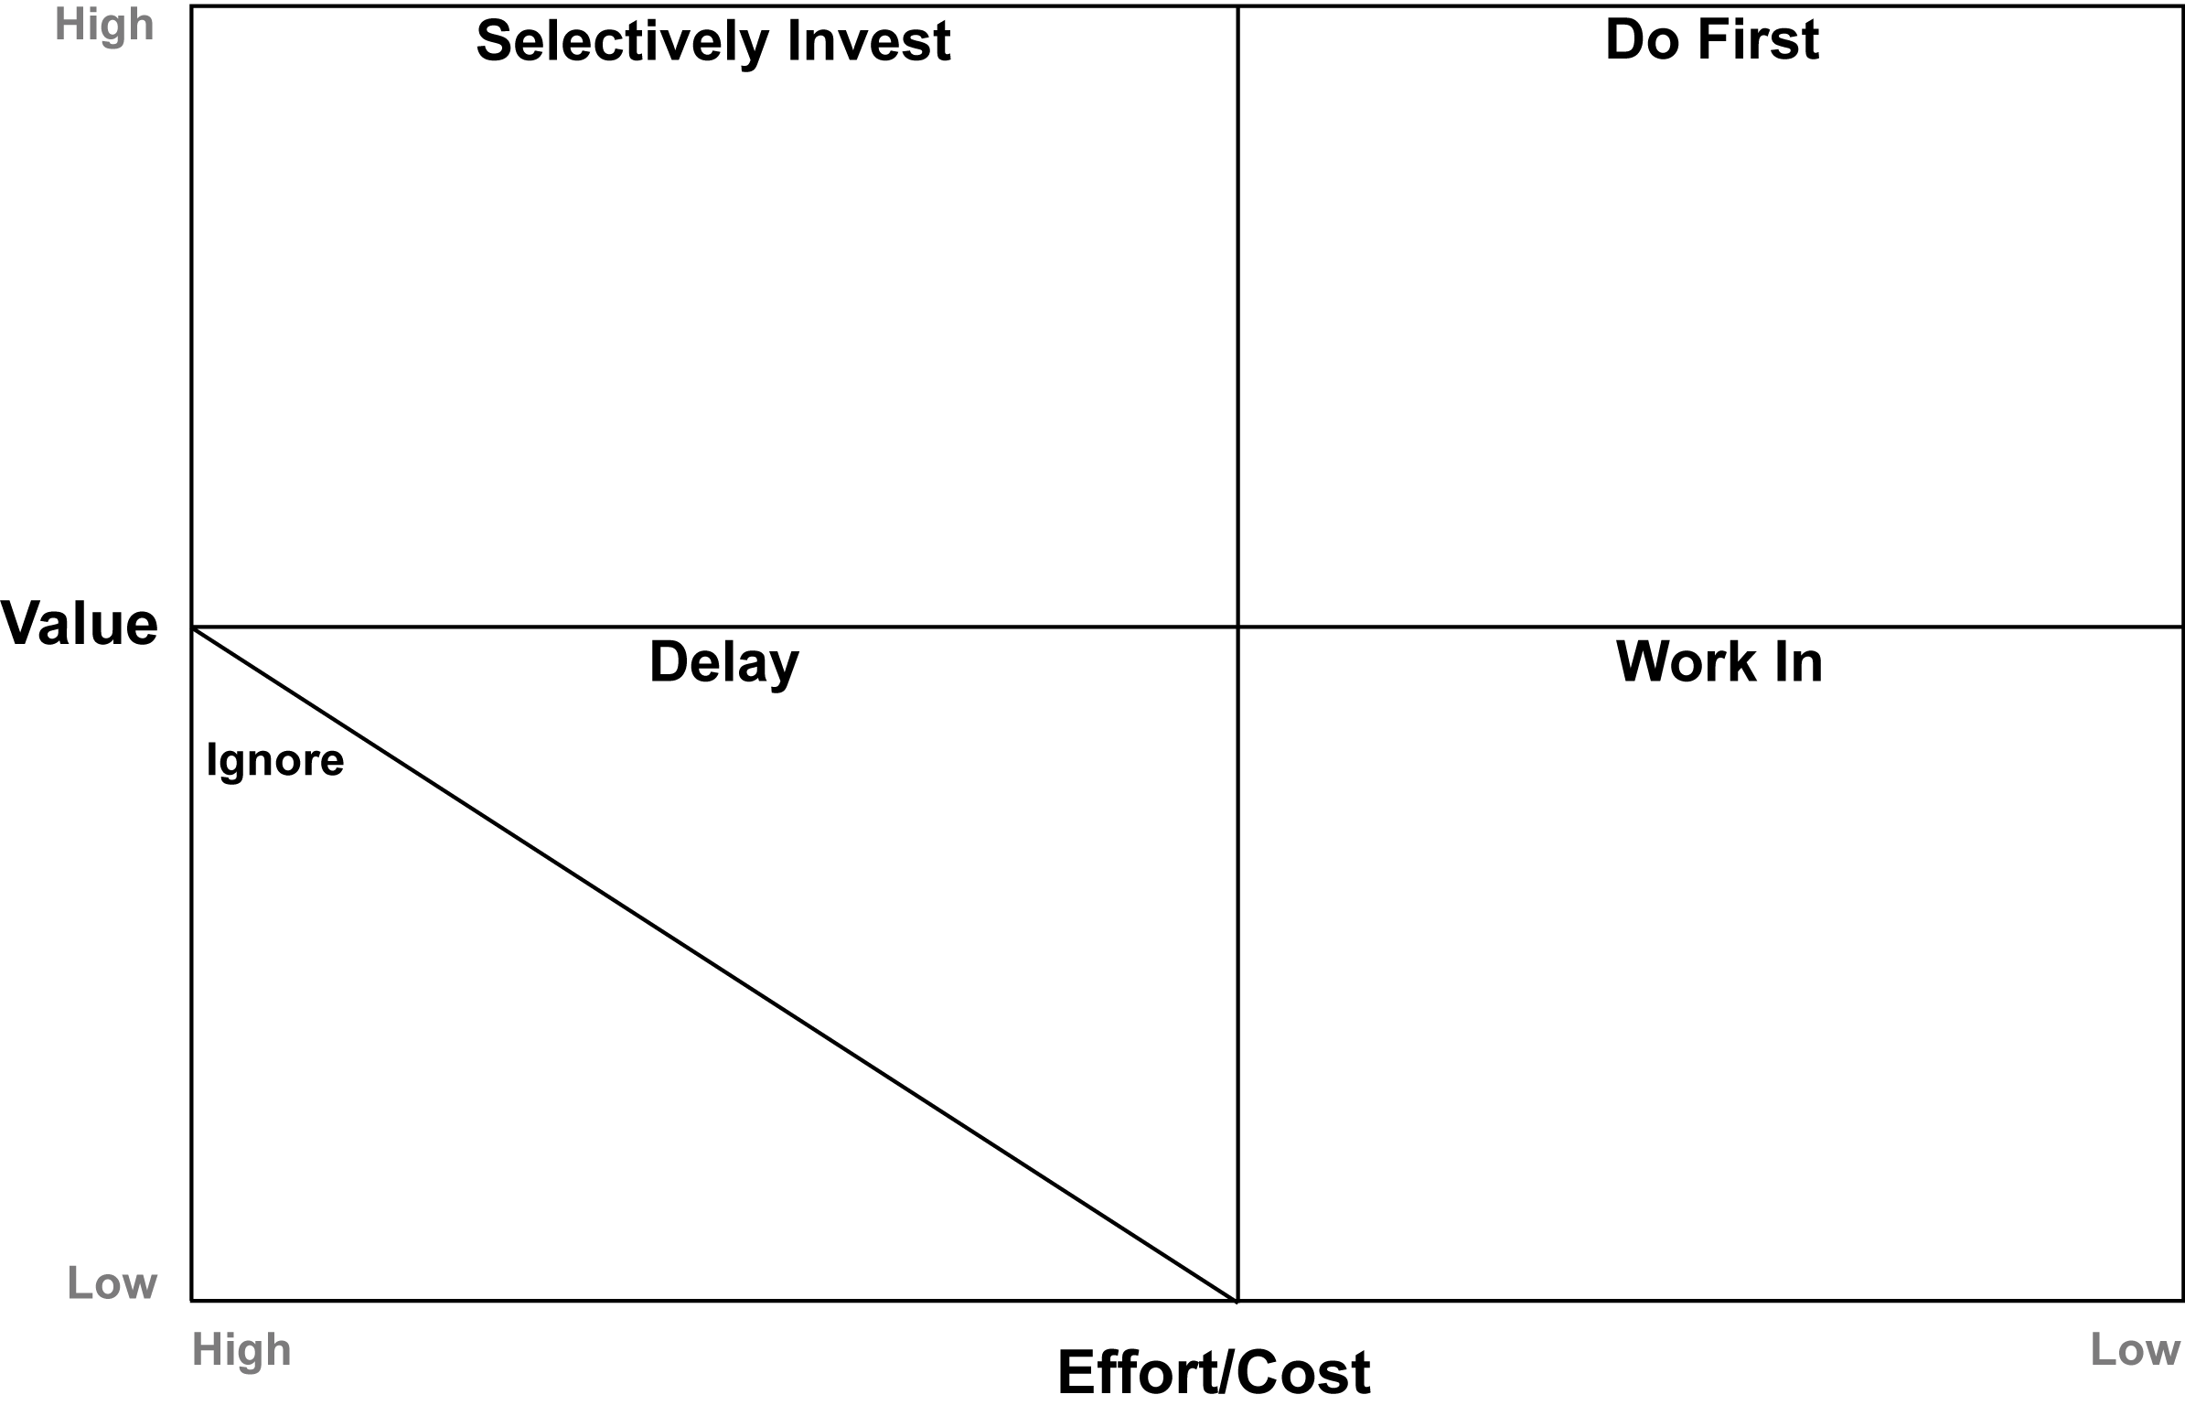
CF/AR Revision Proposal:
FY19 Human Resources 2x2 – Talent Management
Recruiting Strategy to Attract Top Talent and Build a Talent Pipeline that Aligns with Culture & Desired Results
~ Establish Talent Committee
~ Recruiting, Talent Management & Onboarding in Workday
~ Update New Hire Orientation
~ Update Exit Process
~ Roll Out New EE Referral Program
~ Roll Out New Relocation Policy
~ Update ORIX Careers WebPage
Design Program to Identify & Retain High Potential (HiPo) Employees
~ Career Path
~ Succession Planning
Identify and Encourage Cross-Functional Learning & Enrichment Opportunities for HR Team Members
Identify and Deploy Change Management Strategy for New Performance Evaluation Process
OCMS Strategy and Integration Process
~ Identify/Implement strategy, philosophy, structure & model
~ Identify how/what Shared Services will be leveraged vs kept internally
~ Workday integration of LP
~ Workforce planning for integrated teams
~ Change management strategy
~ Deploy roles, identify skill gaps
~ Define/delegate body of work
~ Identify best practices/processes
Drive Daily
Create & Implement Enterprise Change Management Strategy for ORIX USA & Subsidiaries
-Future M&A activity
-OCMS
-Mariner
-NXT Capital
Create & Implement
ORIX USA
Workforce
Planning Strategy
Create & Implement
Talent Management Plan
-Career Pathing
-Performance Management
-Organization Design
-Key Employees
-Succession Planning
Goal Setting
Provide Personal
Learning & Development
Opportunities
for Talent Team
-On-The-Job Training
-Classroom/Lecture
-Coaching/Mentoring
Conduct
Needs Assessment
for Employee
Training Programs
Reimagine HR
~ Identify model and strategy for team to support ORIX and subs
~ Change mgmt. strategy for HRBP model (if approved)
Stakeholder Engagement Surveys
~ Who/What Do We Want to Be?
OCMS HR Strategy, Business Model & Structure
Identify
Areas for Streamlining
Talent Management
Processes & Procedures
Create Enterprise Search Firm Strategy
Identify Employee
Engagement
Initiatives
“Best Places to Work”
~ Baseline Survey in 2018
~ Finalist by 2020
Employee Service Awards
Update ORIX Open & Career Websites for ORIX and Newco
Launch ORIX University
Begin “Best Places
to Work”
Initiative
Reimagine HR
Create Talent Acquisition Strategy for ORIX USA & Subsidiaries
Identify & Develop
ORIX USA
Enterprise
HR Model
Design High Potential
(HiPo)
Program
Launch ORIX University
~ Curriculum for L&D
~ Thought Leadership
~ Individual Learning Paths
Streamline/Automate and Document HR Processes & Procedures
Create Framework for
Diversity & Inclusion
Plan
HR Metrics & HCM
Dashboard in Workday
Begin Framework for Diversity & Inclusion Plan for FY20
HR Metrics and HCM Dashboard for Managers in Workday

Slide 7
Human Resources 2 X 2 Talent Management FY2019
Team Working Edits
(MBD/CF/AR)
September 19, 2018

Slide 8
Recruiting Strategy to Attract Top Talent and Build a Talent Pipeline that Aligns with Culture & Desired Results
~ Establish Talent Committee
~ Recruiting, Talent Management & Onboarding in Workday
~ Update New Hire Orientation
~ Update Exit Process
~ Roll Out New EE Referral Program
~ Roll Out New Relocation Policy
~ Update ORIX Careers WebPage
Create Talent Acquisition Strategy for ORIX USA & Subsidiaries to Attract Top Talent and Build a Talent Pipeline that Aligns with Culture & Desired Results
-Workforce Planning
-Search Firms
-Pipelining
Establish Talent Committee
~ Recruiting, Talent Management & Onboarding in Workday
~ Update New Hire Orientation
~ Update Exit Process
~ Roll Out New EE Referral Program
~ Roll Out New Relocation Policy
~ Update ORIX Careers Web Page
CF Revision Proposal:
FY19 Human Resources 2x2 – Talent Management
Design Program to Identify & Retain High Potential (HiPo) Employees
~ Career Path
~ Succession Planning
Identify and Encourage Cross-Functional Learning & Enrichment Opportunities for HR Team Members
Identify and Deploy Change Management Strategy for New Performance Evaluation Process
OCMS Strategy and Integration Process
~ Identify/Implement strategy, philosophy, structure & model
~ Identify how/what Shared Services will be leveraged vs kept internally
~ Workday integration of LP
~ Workforce planning for integrated teams
~ Change management strategy
~ Deploy roles, identify skill gaps
~ Define/delegate body of work
~ Identify best practices/processes
Drive Daily
Create & Implement Enterprise Change Management Strategy for ORIX USA & Subsidiaries
-Future M&A activity
-OCMS
-Mariner
-NXT Capital
Create & Implement
ORIX USA
Workforce
Planning Strategy
Create & Implement
Talent Management Plan
-Career Pathing
-Performance Management
-Organization Design
-Key Employees
-Succession Planning
Goal Setting
Provide Personal
Learning & Development
Opportunities
for Talent Team
-On-The-Job Training
-Classroom/Lecture
-Coaching/Mentoring
Conduct
Needs Assessment
for Employee
Training Programs
Reimagine HR
~ Identify model and strategy for team to support ORIX and subs
~ Change mgmt. strategy for HRBP model (if approved)
Stakeholder Engagement Surveys
~ Who/What Do We Want to Be?
OCMS HR Strategy, Business Model & Structure
-Design of HRBP Model
-Change Plan
-Execute & Deploy HRBP
Identify
Areas for Streamlining
Talent Management
Processes & Procedures
Employee Relations
--Review policies/procedures
-Supervisory training
Identify Employee
Engagement
Initiatives
“Best Places to Work”
~ Baseline Survey in 2018
~ Finalist by 2020
Employee Service Awards
Update ORIX Open & Career Websites for ORIX and Newco
Launch ORIX University
Begin “Best Places
to Work”
Initiative
Reimagine HR
Create Talent Acquisition Strategy for ORIX USA & Subsidiaries
-Workforce Planning
-Search Firms
-Pipelining
Identify & Develop
ORIX USA
Enterprise
HR Model
Design High Potential
(HiPo)
Program
Launch ORIX University
~ Curriculum for L&D
~ Thought Leadership
~ Individual Learning Paths
Streamline/Automate and Document HR Processes & Procedures
Create Framework for
Diversity & Inclusion
Plan
HR Metrics & HCM
Dashboard in Workday
Begin Framework for Diversity & Inclusion Plan for FY20
HR Metrics and HCM Dashboard for Managers in Workday
Notes:
Writing/Blocks in RED: MBD
PEACH FLESH: Andrea
PINK/GREEN/BLUE: Candler

Slide 9
Human Resources 2 X 2 Talent Management FY2019
Consolidation – Draft v1
September 19, 2018

Slide 10
Create Talent Acquisition Strategy for ORIX USA & Subsidiaries to Attract Top Talent and Build a Talent Pipeline that Aligns with Culture & Desired Results
-Workforce Planning
-Search Firms
-Pipelining
-Establish Talent Committee
-Recruiting, Talent Management & Onboarding in Workday
-Update New Hire Orientation
-Update Exit Process
-Roll Out New EE Referral Program
-Roll Out New Relocation Policy
CF Revision Proposal:
FY19 Human Resources 2x2 – Talent Management
OCMS Strategy and Integration Process
-Identify/Implement strategy, philosophy, structure & model
-Identify how/what Shared Services will be leveraged vs kept internally
-Workday integration of LP
~ Workforce planning for integrated teams
-Change management strategy
-Deploy roles, identify skill gaps
-Define/delegate body of work
-Identify best practices and processes
Drive Daily
Create & Implement Enterprise Change Management Strategy for ORIX USA & Subsidiaries
-Future M&A activity
-OCMS
-Mariner
-NXT Capital
Create & Implement
Talent Management Plan
-Career Pathing
-Performance Management
-Performance Evaluations
-Organization Design
-Key Employees
-Succession Planning
Goal Setting
-HiPo Program
Provide Personal
Learning & Development
Opportunities
for Talent Team
-On-The-Job Training
-Classroom/Lecture
-Coaching/Mentoring
Employee Relations
-Review policies/procedures
-Supervisory training
Develop & Implement
HR Strategy, Business Model & Structure
-Design of HRBP Model
-Change Plan
-Execute & Deploy HRBP
Identify
Areas for Streamlining
Talent Management
Processes & Procedures
Streamline/Automate and Document HR Processes & Procedures
Update ORIX Open & Career Websites for ORIX and Newco
Begin “Best Places
to Work”
Initiative
HR Metrics and HCM Dashboard for Managers in Workday
Identify Employee
Engagement
Initiatives
-Service Awards
-etc.
Reimagine HR
-Stakeholder Engagement Surveys
-Who/What Do We Want to Be?
-Branding
Create Framework for
Diversity & Inclusion
Plan
Create Learning & Development
Program
-Conduct Needs Assessment
for Employee Training Programs
-Launch ORIX University
-Curriculum for L&D
-Thought Leadership
-Individual Learning Paths
Notes:
Boxes in ORANGE are items that were moved from one place to another. Other colors are not relevant for this slide.

