Slide 1
Human Resources 2 X 2 OCMS FY2019
2x2 Working Session
October 29, 2018

Slide 2
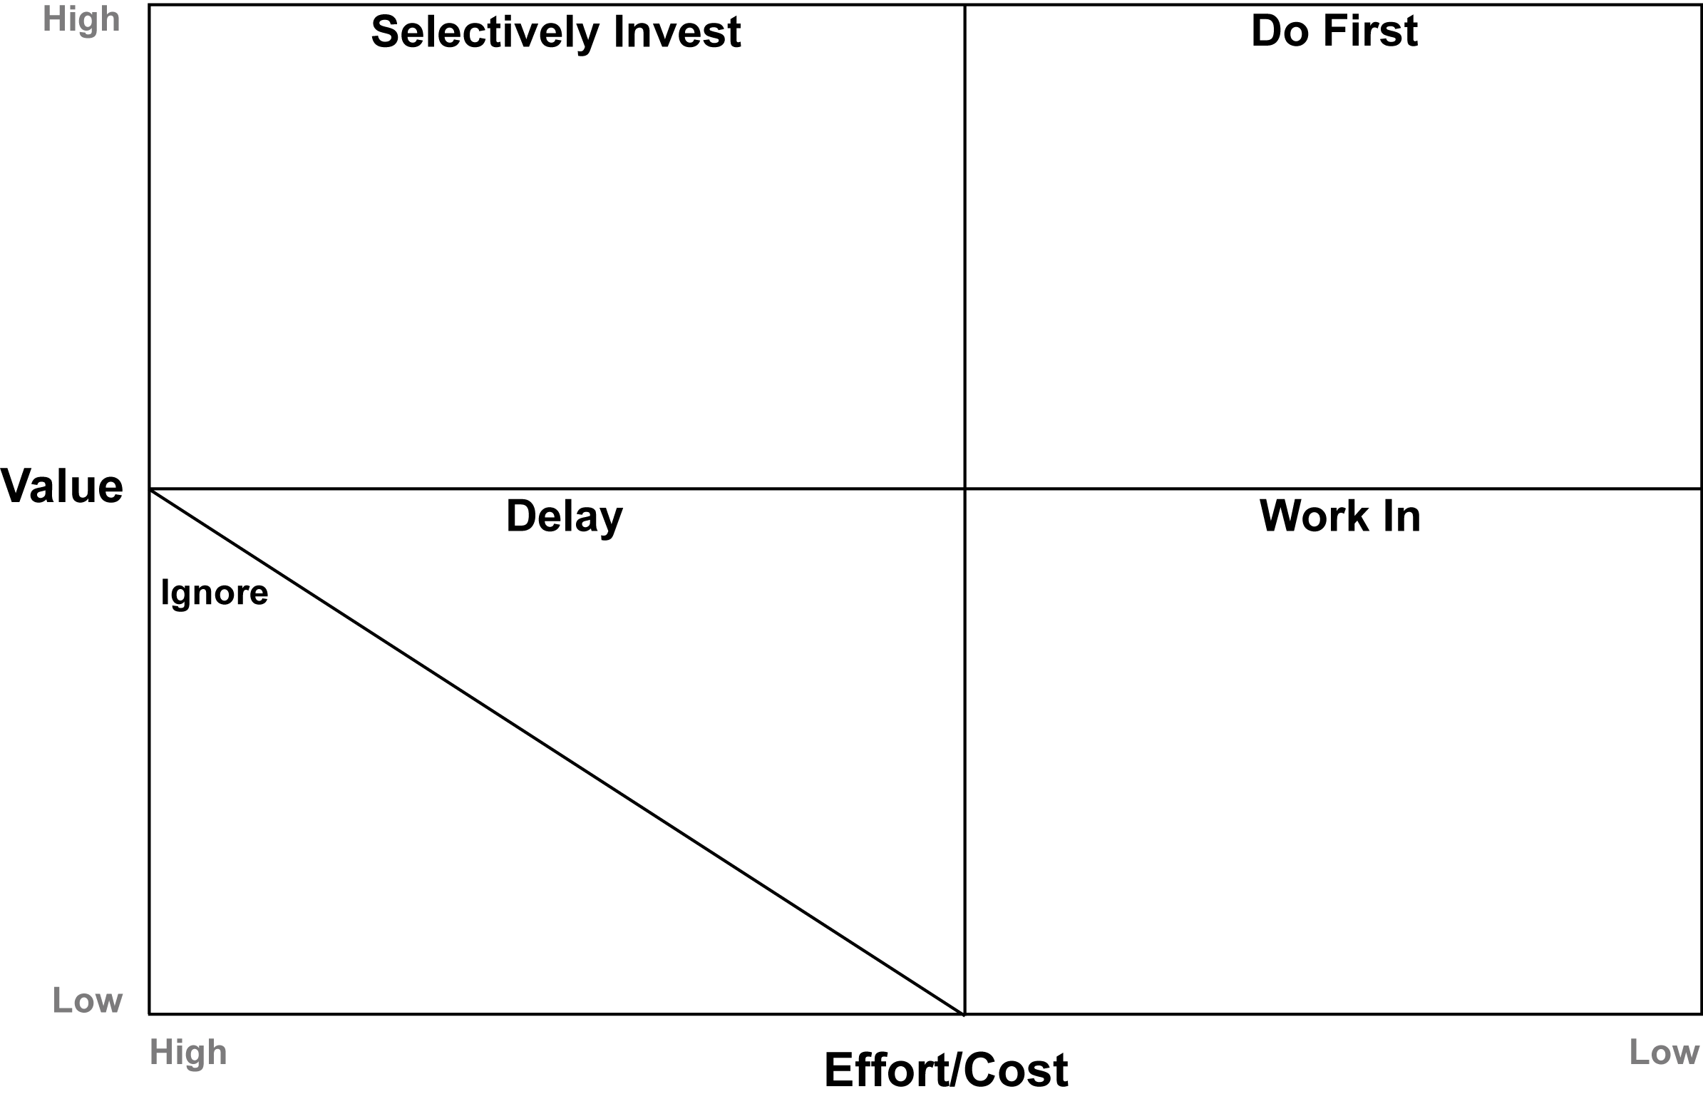
DRAFT:
FY19 Human Resources 2x2 – OCMS
*Red font denotes 1/1/19 deliverables
*Black font denotes 3/31/19 deliverables
Create Talent Management Strategy for OCMS
-Talent acquisition model, structure & resource deployment
-Recruiting, talent management & onboarding
-Develop & implement New Hire Orientation
-Develop & implement exit process
-OCMS workforce planning
-Sourcing & pipelining
Drive Daily
OCMS Strategy & Integration
-Define HR strategy
-Define HR model & organizational design/structure
-Identify how/what COE services will be leveraged vs kept internally
-Change management strategy
Develop & Implement Model
-Define Roles & Responsibilities
-Deploy roles, identify skill gaps
-Define/delegate body of work
-Integration deployment and execution
-Identify best practices & processes
-HR roadshow & communication
OCMS Benefits Strategy
& Execution
-Plan design and harmonization
-Change management
-Deployment
-Enrollment
Culture
-Stagen education deployment and principle sustainability
-Post-merger EE engagement
Compensation Administration
-Post-1/1 compensation strategy design, change management and administration
Benefits Administration
- Post-1/1 benefit administration
OCMS Workday
-Design and testing
-Data integration
-Change management
-Phase I implementation
-Phase II implementation
-Workday launch
Implement
Talent Management Plan
-Career pathing
-Performance management
-Performance evaluations
-Goal setting
Analyst Programs
-Summer internship program- cross-functional design & staffing
-Associate development program (rotation)- cross-functional design & staffing
OCMS Total Rewards
-Compensation strategy
-Titling & compensation calibration
-Originator assessment & comp design
-Compensation design implementation
-Compensation reconciliation
-Change management
-Deployment
Policies & Guides
-Complete policy side-by-side assessment
-Harmonize policies and employee guides
-HR & legal review and approval
-Create and publish employee resources guides
-Acknowledgment process
Wellness Program
Create Learning & Development
Program
-Conduct Needs Assessment
for Employee Training Programs
-Curriculum for L&D
-Thought Leadership
-Individual Learning Paths
Succession Planning
HiPo Program
Update Career Websites & Intranets for NewCo
Reimagine HR
-Stakeholder Engagement Surveys
-Who/What Do We Want to Be?
-Branding
HR Metrics and HCM Dashboard for Managers in Workday
Notes:
Boxes in ORANGE are items that were moved from one place to another. Other colors are not relevant for this slide.

